Slide 1
Producing Accessible Graphics
Round Table Conference Workshop 2021

Slide 2
Workshop plan
Introduction & history
What’s new
Approach
New sections
Focus on selected diagram types (the nitty gritty)
Artwork
Graphic Novels
Chemistry (have your lollies and toothpicks ready!)
Node link diagrams
Orthographic drawing
3D models
Electronic symbols

Slide 3

History
Working groups:
1997 draft
2001-2004:
Guidelines for Conveying Visual Information (2005)
2019-2021:
Guidelines on Producing Accessible Graphics (2021)

Slide 4

Approach
Language to reflect the shift in methods for producing accessible graphics
More in depth information on producing accessible graphics
Updated examples

Slide 5
What’s New
Contents
General Principles for producing accessible graphics with reference to
Clear Print
3D models
Sonification

Slide 6
Contents continued
Example Accessible Graphics
Banners
Logos
Icons
Emoticons
Graphic Novels
Picture Story Books

Slide 7
Contents continued
Network Diagrams
Electronics (inclusion of an updated Electronic Symbols List)

Slide 8
Accessibility of the document
Accessible content benefits everyone.
Microsoft Word interface is reasonably accessible.
Assistive technologies like screen readers and Braille devices can easily interpret documents.
The document was formatted using the Guidelines for Producing e-Text Guidelines 2018

Slide 9
Accessibility of the document (continued)
Headings and structure (H1, H2, H3, etc.)
Using Sans Serif fonts
Describing all images and illustrations (Alt text)
Ensuring links are active and descriptive

Slide 10
Choosing a format
Use a variety of formats
Omission
Descriptions
Clear Print
Tactile Graphics
3D Models
Sonification

Slide 11
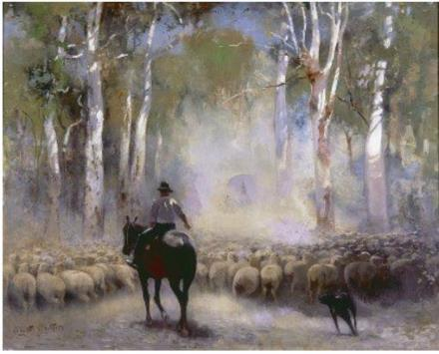
Artworks (1/2)
The Drover (1912)
by Walter Withers
Oil on canvas

Slide 12
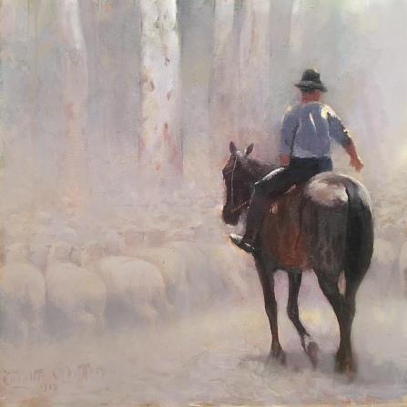

Artworks (2/2)
Use a variety of approaches:
Enhanced graphics
Description
Tactile graphic
3D model
Related objects
Materials used to create the artwork
Role play
Soundscape or music

Slide 13
Emojis (1/1)
In most cases:
Replace emojis with text descriptions, e.g.
Respond with 👍🏼 if you agree or 👎🏼 if you disagree.
Respond with [thumbs up emoji] if you agree or [thumbs down emoji] if you disagree.
Refer to Emoji: https://emojipedia.org/ for the standard emoji names.
If emojis are being studied you may consider:
Emojis as tactile graphics
Keyboard shortcuts to create the emojis ;)

Slide 14
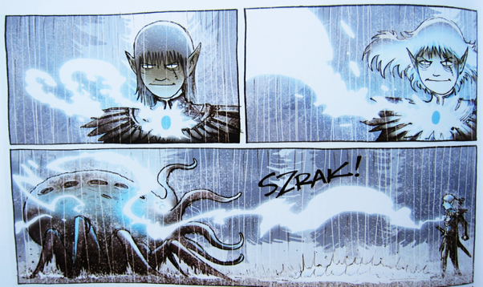
Graphic Novels
Convey the story in an easy and entertaining fashion

Slide 15

Graphic Novels continued
Include simple tactile graphics

Slide 16
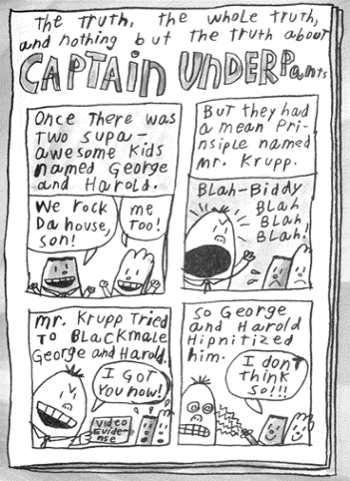
Graphic novels continued
Can also be in comic strip format

Slide 17
Chemistry (1/5)
Participant Activity
Grab your toothpicks and lollies it’s time to have some fun.

Slide 18
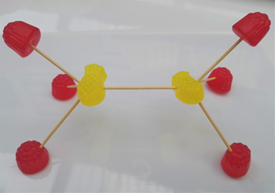
Chemistry (2/5)

Slide 19
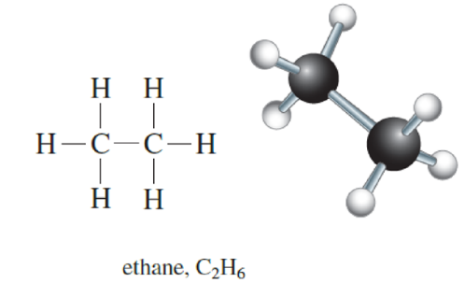
Chemistry (3/5)
Chemical Structures

Slide 20

Chemistry (4/5)

Slide 21

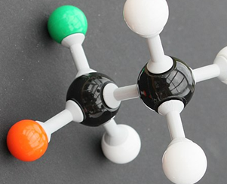
Chemistry (5/5)

Slide 22
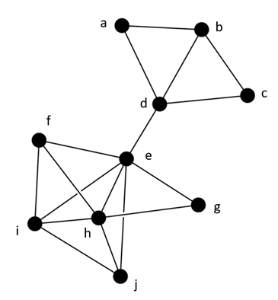
Node Link Diagrams / Network Graphs (1/3)
Nodes = points (items)
Links = lines (relationships)
Yang, Y., Marriott, K., Butler, M., Goncu, C., & Holloway, L. (2020). Tactile Presentation of Network Data: Text, Matrix or Diagram? https://arxiv.org/pdf/2003.14274.pdf

Slide 23
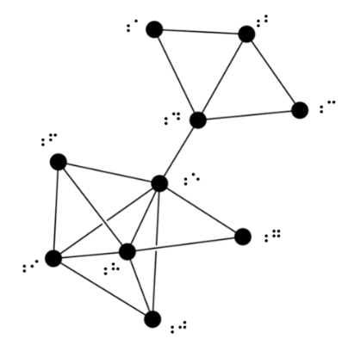
Node Link Diagrams / Network Graphs (2/3)
Use a tactile graphic for:
Illustrating the concept of node link diagrams
Looking for clusters
Finding pathways

Slide 24
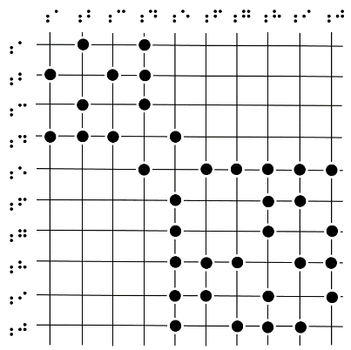
Node Link Diagrams / Network Graphs (3/3)
Matrix
Retain only to illustrate what a matrix is.
Otherwise, convert to a list format,
e.g.
A is linked with B and D
B is linked with A, C and D

Slide 25
Orthographic drawings
Participant Activity
Time to use your lego blocks

Slide 26
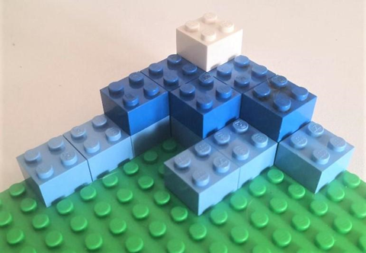
Orthographic drawings
This is how your 3D-model should look. How did you go?

Slide 27
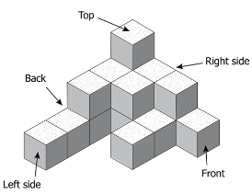
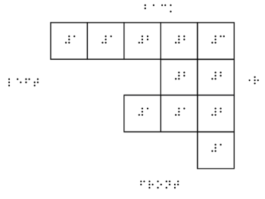
Orthographic drawings
3D models are ideal and can be constructed from Lego, or wooden blocks or similar.
As a tactile, a mat plan is the simplest.
Descriptions are not recommended.
Use a transcriber’s note.

Slide 28
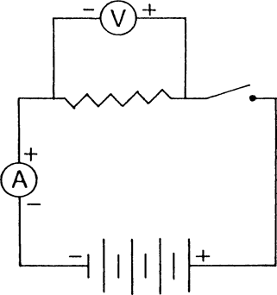
Electronic symbols (1/4)
Circuit diagram
Can be shown in braille or tactually

Slide 29
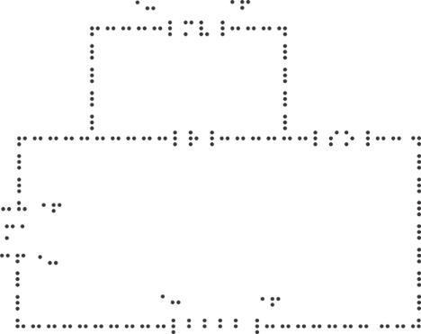
Electronic symbols (2/4)
Braille version of a circuit
Reproducible using Duxbury
or a brailler
Symbols list in guidelines

Slide 30
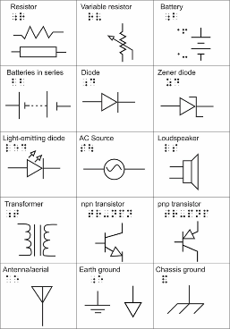
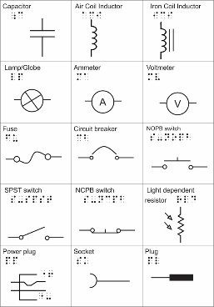
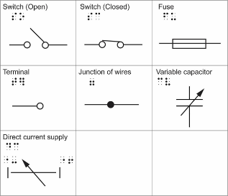
Electronic symbols (3/4)

Slide 31
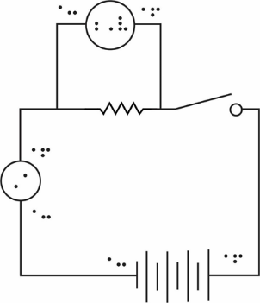
Electronic symbols (4/4)
Tactile diagram of the circuit
For more on producing tactile electronic
Symbols see Designing Tactile Schematics
by Lauren Race

Slide 32
Question and Answer Time
The guidelines will be released at Producing Accessible Graphics: http://printdisability.org/guidelines/graphics-2021/

Slide 33
For Further Information
If you require any further information with regards to these guidelines contact Annette Sutherland
annette.sutherland2@gmail.com

